Slide 1

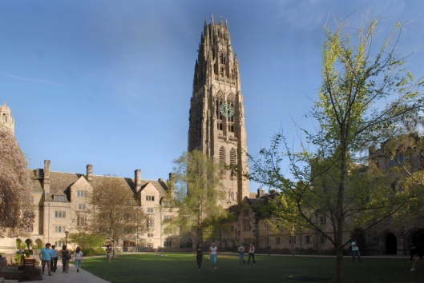
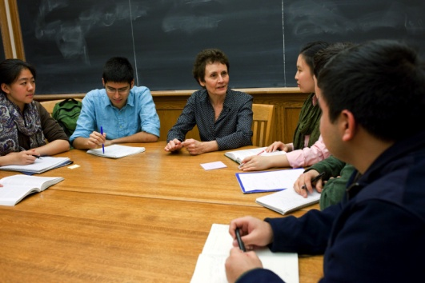
Two Information Sessions on…
SEOUL Session
Date & Time | Monday – June 4, 2012 – 7:00pm
Venue | Seoul International School 388-14 Bokjeong-dong, Sujeong-gu, Seongnam, Gyeonggi-do, Seoul, South Korea 461-200
Registration | https://apps.admissions.yale.edu/register/seoul
Hankuk Academy of Foreign Studies Session
Date & Time | Monday – June 4th, 2012 – 8:20am
Venue | Audio visual room
Please join Keith Light, Associate Director of Admissions at Yale, and Austin Shiner, Admissions Counselor at Yale-NUS, to learn more about Yale University and Asia’s first residential liberal arts institution, Yale-NUS College.
Academic programs, student life, international opportunities, admissions policies, and tuition and financial aid at each school will be discussed.

